Slide 1
Sockets in Java

Slide 2
What is sockets?
Java Socket programming is used for communication between the applications running on different JRE.
Java Socket programming can be connection-oriented or connection-less.
Connection oriented | connection-less
Socket and ServerSocket classes are used. | DatagramSocket and DatagramPacket classes are used.

Slide 3
Requirements:
IP Address of Server, and
Port number.
Classes used:
Socket
Server Socket

Slide 4
Socket class
The Socket class is used to communicate client and server.
Through this class, we can read and write message.
A socket is simply an endpoint for communications between the machines. The Socket class can be used to create a socket.
Method | Description
1) public InputStream getInputStream() | returns the InputStream attached with this socket.
2) public OutputStream getOutputStream() | returns the OutputStream attached with this socket.
3) public synchronized void close() | closes this socket

Slide 5
Socket class
Method | Description
1) public InputStream getInputStream() | returns the InputStream attached with this socket.
2) public OutputStream getOutputStream() | returns the OutputStream attached with this socket.
3) public synchronized void close() | closes this socket

Slide 6
Socket s=new Socket("localhost",6666);

Slide 7
ServerSocket
The ServerSocket class is used at server-side.
The accept() method of ServerSocket class blocks the console until the client is connected.
After the successful connection of client, it returns the instance of Socket at server-side.

Slide 8
Method | Description
1) public Socket accept() | returns the socket and establish a connection between server and client.
2) public synchronized void close() | closes the server socket.

Slide 9
Server creation
ServerSocket ss=new ServerSocket(6666);
Socket s=ss.accept();//establishes connection and waits for the client

Slide 10
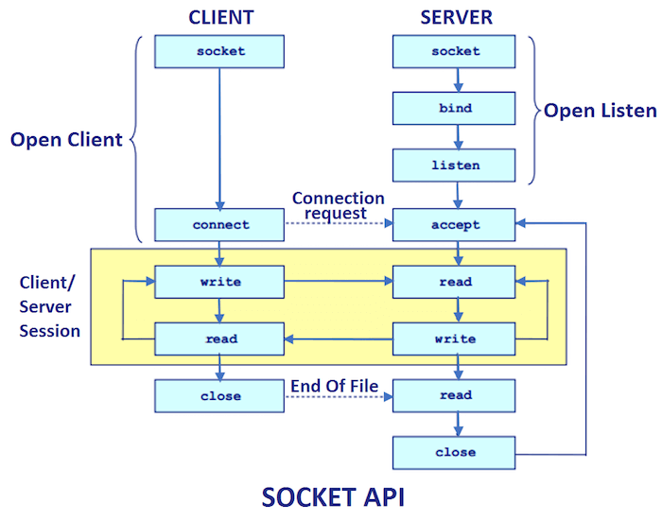

Slide 11
Implementation
1)Server program
2)Client program

Slide 12
Server program
import java.io.*;
import java.net.*;
public class MyServer {
public static void main(String[] args){
try{
ServerSocket ss=new ServerSocket(6666);
Socket s=ss.accept();//establishes connection
DataInputStream dis=new DataInputStream(s.getInputStream());
String str=(String)dis.readUTF();
System.out.println("message= "+str);
ss.close();
}catch(Exception e){System.out.println(e);}
}
}

Slide 13
Client Program
import java.io.*;
import java.net.*;
public class MyClient {
public static void main(String[] args) {
try{
Socket s=new Socket("localhost",6666);
DataOutputStream dout=new DataOutput
Stream(s.getOutputStream());
dout.writeUTF("Hello Server");
dout.flush();
dout.close();
s.close();
}catch(Exception e){System.out.println(e);}
}
}

